Slide 1
ICT 2103 Digital Logic Design
Prof. Dr. Muhammad Shahin Uddin
Email:shahin.uddin@mbstu.ac.bd

Slide 2
Combinational Circuits
Output is function of input only
i.e. no feedback
When input changes, output may change (after a delay)
Combinational
Circuits
n inputs
m outputs
•
•
•
•
•
•
✗

Slide 3
Combinational Circuit Vs. Sequential Circuit
Combinational Circuit | Sequential Circuit
Output depends only upon present input | Output depends upon present as well as past input
Speed is fast. | Speed is slow.
It is designed easy. | It is designed tough as compared to combinational circuits.
There is no feedback between input and output. | There exists a feedback path between input and output.
This is time independent. | This is time dependent.
Elementary building blocks: Logic gates | Elementary building blocks: Flip-flops
Used for arithmetic as well as Boolean operations. | Mainly used for storing data.
Combinational circuits don’t have capability to store any state. | Sequential circuits have capability to store any state or to retain earlier state.
As combinational circuits don’t have clock, they don’t require triggering. | As sequential circuits are clock dependent they need triggering.
These circuits do not have any memory element. | These circuits have memory element.
It is easy to use and handle. | It is not easy to use and handle.
Examples: Encoder, Decoder, and Multiplexer, Demultiplexer | Examples: Flip-flops, and Counters

Slide 4
Sequential Circuits
Asynchronous
Synchronous
Combinational
Circuit
Inputs
Outputs
Memory Elements
Combinational
Circuit
Inputs
Outputs
Flip-flops
Clock

Slide 5
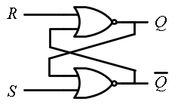
SR Latch :
NOR
NAND
Case 3:
S=1, R=1 Q=0 Q’=0
1 0 0 0
S=0, R=0 Q=0 Q’=0
Reset
Q=0
0 0 1 1
Reset
Q=0
0
Q’=1 0
1
0 0 1 0
Q=0
1 1 0 0
1
0
Set
=1
Set
=1
Case 1:
S=0, R=1
Q= 0
=1
No Change: (Memory )
A | B | Y
0 | 0 | 1
0 | 1 | 0
1 | 0 | 0
1 | 1 | 0
S=0, R=0
Q= 0
=1
S=1, R=0
Q= 1
=0
No Change: Memory
Case 2:
S=0, R=0
Q= 1
=0

Slide 6
Latches
SR Latch
S R Q₀ | Q | Q’
0 0 0 | 0 | 1
0 0 1 | 1 | 0
0 1 0 | 0 | 1
0 1 1 | 0 | 1
1 0 0 | 1 | 0
1 0 1 | 1 | 0
1 1 0 | 0 | 0
1 1 1
Q = Q₀
1
1
Q = 0
0
Q = 1
Q = Q’
0 | 0
Q = Q’
1
0

Slide 7
Latches
SR Latch
S R | Q
0 0 | Q₀
0 1 | 0
1 0 | 1
1 1 | Q=Q’=0
No change
Reset
Set
Invalid
S
Q
C S R | Q
0 x x | Q₀
1 0 0 | Q₀
1 0 1 | 0
1 1 0 | 1
1 1 1 | Q=Q’
SR Latch with Control Input
No change
No change
Reset
Set
Invalid
R
Q

Slide 8

Controlled Latches
D Latch (D = Data)
D
D
Q
C
Q
C D | Q
0 x | Q₀
1 0 | 0
1 1 | 1
No change
Reset
Set

Slide 9
Controlled Latches
D Latch (D = Data)
Timing Diagram
C
D
Q
D
C
Q
Q
t
Q (t+1) = D
When Clock is enabled
Q(t+1) = Q(t)
When Clock is disabled
C D | Q
0 x | Q₀
1 0 | 0
1 1 | 1
Output may change
No change
Reset
Set

Slide 10
Controlled Latches (Task 1)
D Latch (D = Data)
Timing Diagram
C
D
Q
D
Q
Q
Q (t+1) = D
When Clock is enabled
Q(t+1) = Q(t)
When Clock is disabled
t
C D | Q
0 x | Q₀
1 0 | 0
1 1 | 1
Output may change
No change
Reset
Set

Slide 11
Controlled Latches
D Latch (D = Data)
Timing Diagram
C
D
Q
D
Q
Q
C D | Q
0 x | Q₀
1 0 | 0
1 1 | 1
Output may change
No change
Reset
Set
Q (t+1) = D
When Clock is enabled
Q(t+1) = Q(t)
When Clock is disabled

Slide 12
Flip-Flops
Controlled latches are level-triggered
Flip-Flops are edge-triggered
Q (t+1) = D
When Clock is enabled
Q(t+1) = Q(t)
When Clock is disabled
C
CLK
Positive Edge
CLK
Negative Edge

Slide 13
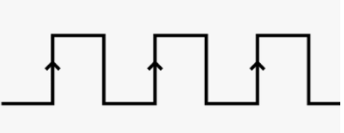
S | R | Q | Q’
0 | 0 | NO change
0 | 1 | 0
1 | 0 | 1
1 | 1 | Not Used
High Falling Edge
High
High Falling Edge

Slide 14
Flip-Flops
Master-Slave D Flip-Flop
D Latch
(Master)
D Latch
(Slave)
D
D
C
Q
D
C
Q
Q
Master
Slave
CLK
CLK
D
Looks like it is negative edge-triggered
Q_{Master}
Q_{Slave}

Slide 15
Flip-Flops
JK Flip-Flop
J | K | Q(t+1)
0 | 0 | Q(t)
0 | 1 | 0
1 | 0 | 1
1 | 1 | Q’(t)
D = JQ’ + K’Q
J
Q
Q (t+1) = D = JQ’ + K’Q
K
Q

Slide 16
Flip-Flops
T Flip-Flop
T
J
Q
T
D
Q
Q
K
Q
T
Q
D = JQ’ + K’Q
D = TQ’ + T’Q = T ⊕ Q
Q

Slide 17
Flip-Flop Characteristic Equations
Analysis / Derivation
J | K | Q(t) | Q(t+1)
0 | 0 | 0 | 0
0 | 0 | 1 | 1
0 | 1 | 0
0 | 1 | 1
1 | 0 | 0
1 | 0 | 1
1 | 1 | 0
1 | 1 | 1
No change
Reset
Set
Toggle
J
Q
K
Q

Slide 18
Flip-Flop Characteristic Equations
Analysis / Derivation
J | K | Q(t) | Q(t+1)
0 | 0 | 0 | 0
0 | 0 | 1 | 1
0 | 1 | 0 | 0
0 | 1 | 1 | 0
1 | 0 | 0
1 | 0 | 1
1 | 1 | 0
1 | 1 | 1
No change
Reset
Set
Toggle
J
Q
K
Q

Slide 19
Flip-Flop Characteristic Equations
Analysis / Derivation
J | K | Q(t) | Q(t+1)
0 | 0 | 0 | 0
0 | 0 | 1 | 1
0 | 1 | 0 | 0
0 | 1 | 1 | 0
1 | 0 | 0 | 1
1 | 0 | 1 | 1
1 | 1 | 0
1 | 1 | 1
No change
Reset
Set
Toggle
J
Q
K
Q

Slide 20
Flip-Flop Characteristic Equations
Analysis / Derivation
J | K | Q(t) | Q(t+1)
0 | 0 | 0 | 0
0 | 0 | 1 | 1
0 | 1 | 0 | 0
0 | 1 | 1 | 0
1 | 0 | 0 | 1
1 | 0 | 1 | 1
1 | 1 | 0 | 1
1 | 1 | 1 | 0
No change
Reset
Set
Toggle
J
Q
K
Q

Slide 21
Flip-Flop Characteristic Equations
Analysis / Derivation
J | K | Q(t) | Q(t+1)
0 | 0 | 0 | 0
0 | 0 | 1 | 1
0 | 1 | 0 | 0
0 | 1 | 1 | 0
1 | 0 | 0 | 1
1 | 0 | 1 | 1
1 | 1 | 0 | 1
1 | 1 | 1 | 0
J
Q
 |  |  |  | K
 |  | 0 | 1 | 0 | 0
J |  | 1 | 1 | 0 | 1
 |  |  | Q
K
Q
Q(t+1) = JQ’ + K’Q

Slide 22
Flip-Flop Characteristic Tables
D | Q(t+1)
0 | 0
1 | 1
D
Q
Reset
Set
Q
J | K | Q(t+1)
0 | 0 | Q(t)
0 | 1 | 0
1 | 0 | 1
1 | 1 | Q’(t)
J
Q
No change
Reset
Set
Toggle
K
Q
T
Q
T | Q(t+1)
0 | Q(t)
1 | Q’(t)
No change
Toggle
Q

Slide 23
Flip-Flop Characteristic Equations
D | Q(t+1)
0 | 0
1 | 1
D
Q
Q(t+1) = D
Q
J | K | Q(t+1)
0 | 0 | Q(t)
0 | 1 | 0
1 | 0 | 1
1 | 1 | Q’(t)
J
Q
Q(t+1) = JQ’ + K’Q
K
Q
T
Q
T | Q(t+1)
0 | Q(t)
1 | Q’(t)
Q(t+1) = T ⊕ Q
Q

Slide 24
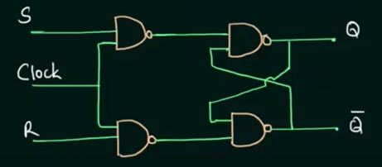
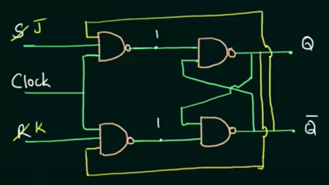
SR and JK flip flop

Slide 25
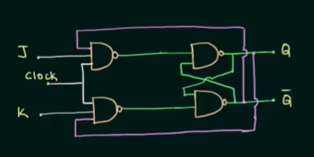
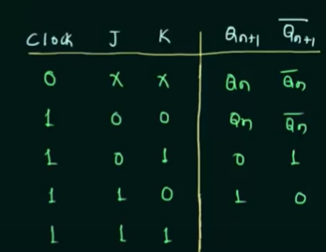
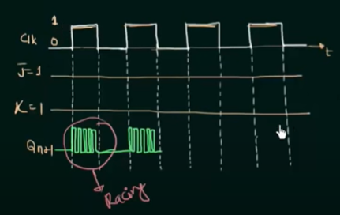
Race Around Condition of JK flip flop
1
0

Slide 26
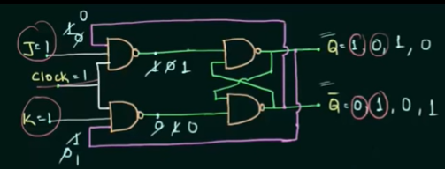
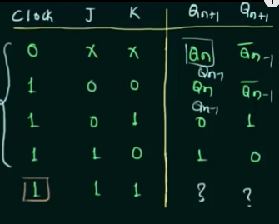
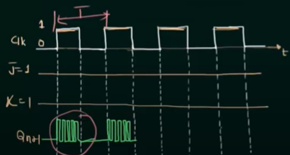
Race Around Condition of JK flip flop
1
0
Conditions to overcome Racing :
T/2<Propagation delay of FF x
Edge Triggering
Master-Slave

Slide 27
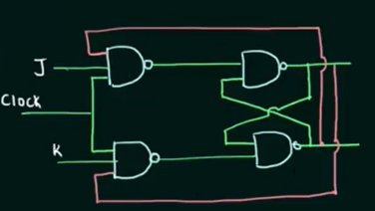
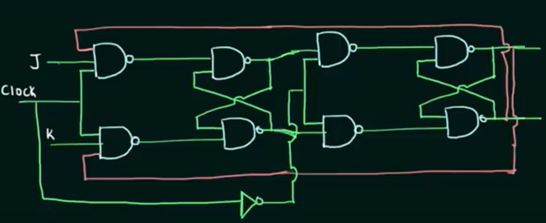
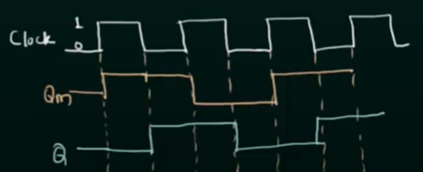
JK flip flop Master Slave Operation of JK flip flop
Qm
Slave
Master
T/2<Propagation Delay of FF
Edge Triggered
Master-Slave (M.S. operation is same as negative edge triggering])

Slide 28
Flip-Flop Characteristic Tables
D | Q(t+1)
0 | 0
1 | 1
D
Q
Reset
Set
Q
J | K | Q(t+1)
0 | 0 | Q(t)
0 | 1 | 0
1 | 0 | 1
1 | 1 | Q’(t)
J
Q
No change
Reset
Set
Toggle
K
Q
T
Q
T | Q(t+1)
0 | Q(t)
1 | Q’(t)
No change
Toggle
Q

Slide 29
Flip-Flop Characteristic Equations
D | Q | Q(t+1)
0 | 0 | 0
0 | 1 | 0
1 | 0 | 1
1 | 1 | 1
J | K | Q(t+1)
0 | 0 | Q(t)
0 | 1 | 0
1 | 0 | 1
1 | 1 | Q’(t)
Q(t+1) = D
D
Q
Q
D
0
1
0 1
0 | 0
1 | 1
Q
KQ
J
Q
J
0
1
00 01 11 10
0 | 1 | 0 | 0
1 | 1 | 0 | 1
K
Q
T | Q | Q(t+1)
0 | 0 | 0
0 | 1 | 1
1 | 0 | 1
1 | 1 | 0
Q(t+1) = JQ’ + K’Q
Q(t+1) = TQ’+T’Q =T ⊕ Q
Q
T
Q
T
0
1
0 1
0 | 1
1 | 0
Q

Slide 30
Clocked Sequential Circuits
Analyzing a clocked sequential circuit
Designing a sequential circuit to address a problem

Slide 31
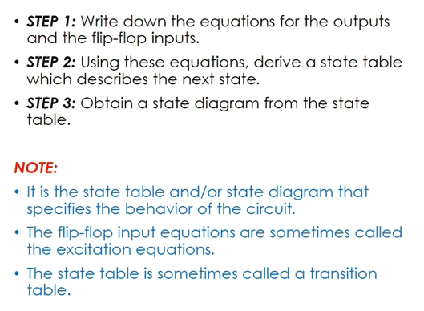
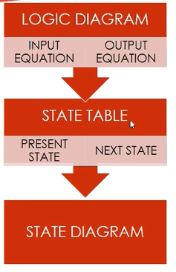
Analyzing a Clocked Sequential Circuit

Slide 32
State Table and State Diagram
State Diagram
The state diagram is the pictorial representation of the behavior of sequential circuits. It clearly shows the transition of states from the present state to the next state and output for a corresponding input.
State table
The information contained in the state diagram is transformed into a table called as state table or state synthesis table. Although the state diagram describes the behavior of the sequential circuit, in order to implement it in the circuit, it has to be transformed into the tabular form.

Slide 33
Analyzing a Clocked Sequential Circuit
A circuit will be given and we must understand the boundary between combinational stage and sequential stage
Then identify the following specifications
No. flip flops and what types
How many external input
How many external output
No. of state variable (n)
No of states, 2^{n}

Slide 34
Analyzing a Clocked Sequential Circuit
Write down the equation of Flip Flop Input, External Output [3]
Write down the equation for flip-flop output (known as state equation). This can be written by combining [3] with the flip flop’s driving equation.
Draw the state table
Draw the state diagram

Slide 35
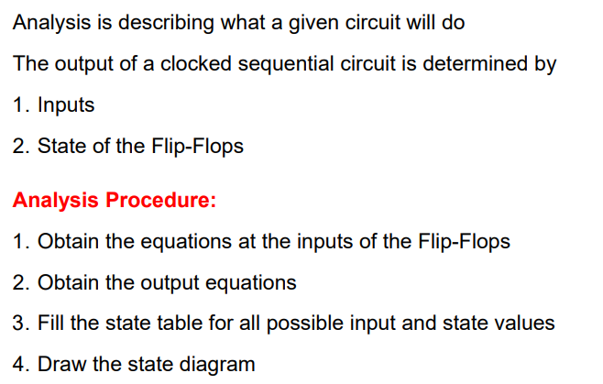
Analyzing a Clocked Sequential Circuit

Slide 36
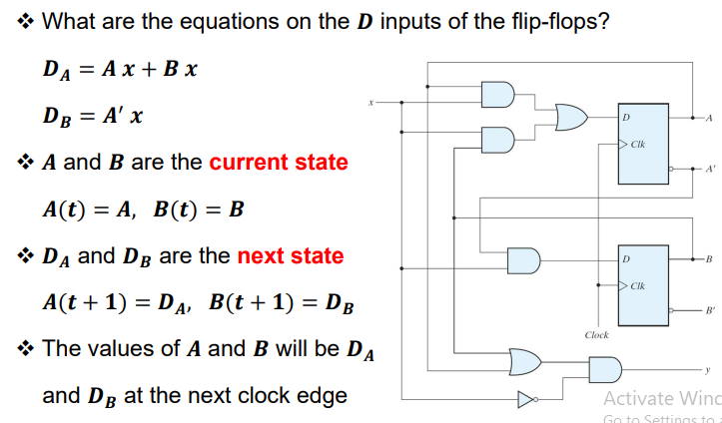
Analyzing a Clocked Sequential Circuit

Slide 37
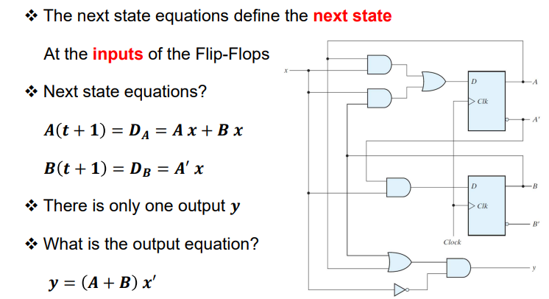
Analyzing a Clocked Sequential Circuit: Next state and output Equations

Slide 38
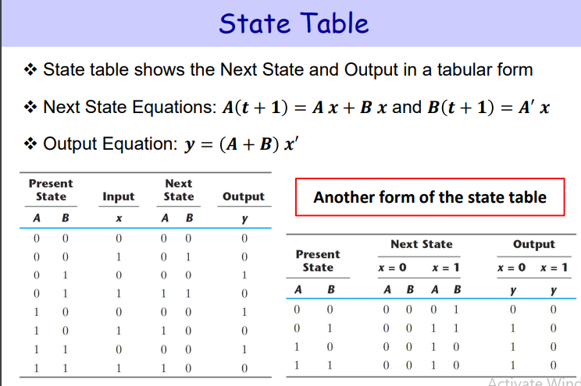
Analyzing a Clocked Sequential Circuit: State Table

Slide 39
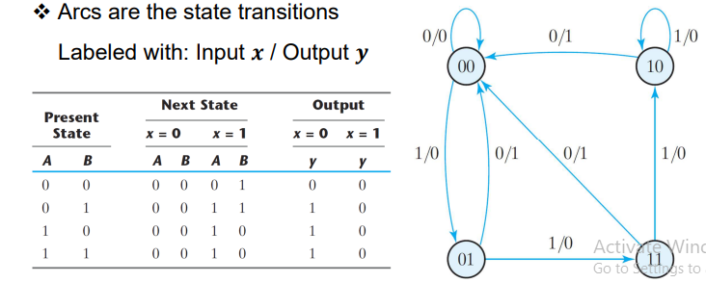
Analyzing a Clocked Sequential Circuit: State Diagram

Slide 40
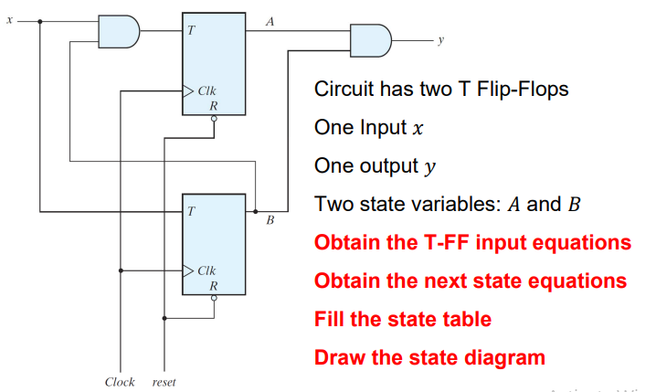
Analyzing a Clocked Sequential Circuit with T Flip-Flop

Slide 41
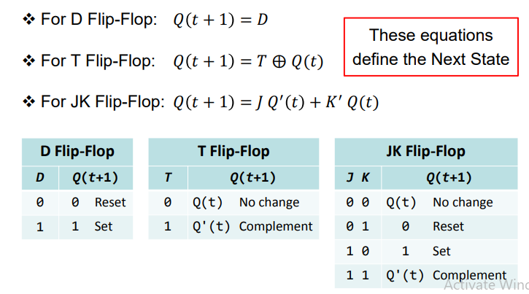
Recall: Flip-flop Characteristic Equation

Slide 42
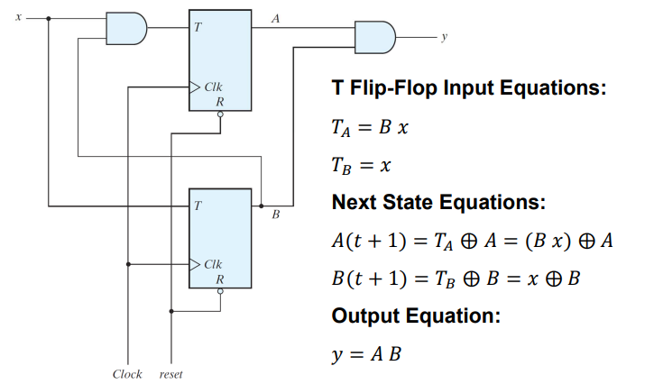
Sequential Circuit with T Flip-flops

Slide 43
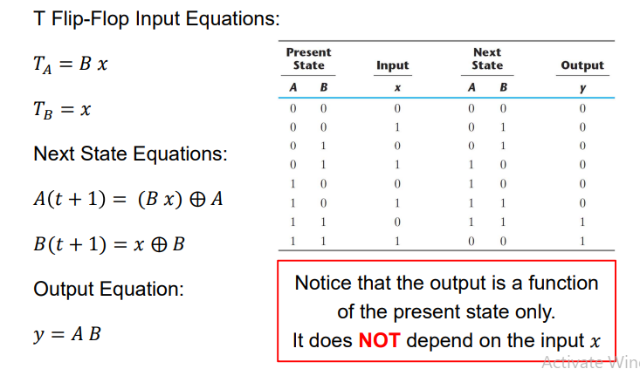
Analyzing a Clocked Sequential Circuit : From Next State Equations to state table

Slide 44
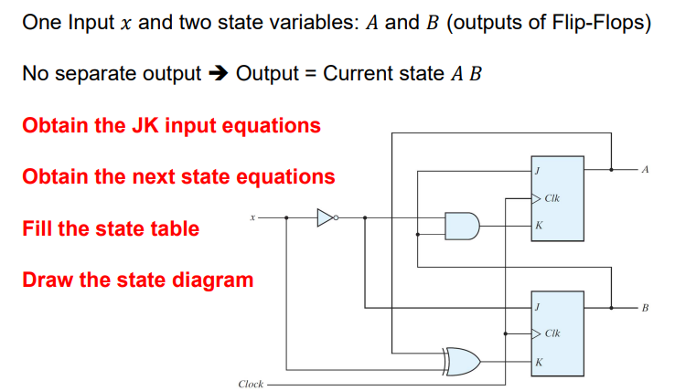
Sequential Circuit with JK FF

Slide 45
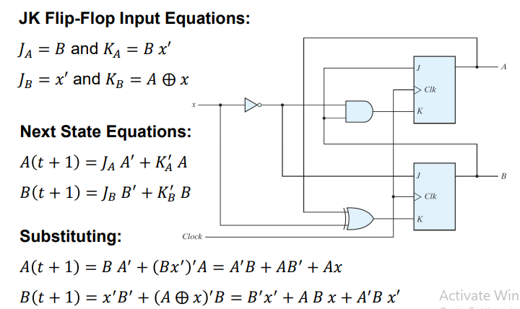
Analyzing a Clocked Sequential Circuit: JK Input and Next State Equations

Slide 46
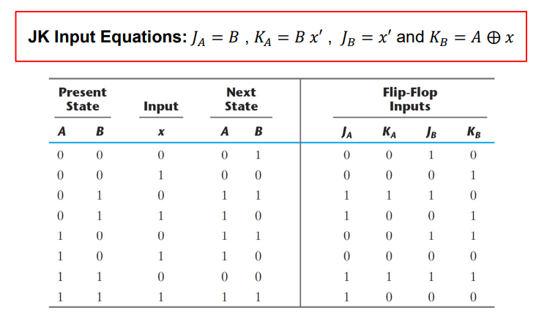
Analyzing a Clocked Sequential Circuit

Slide 47
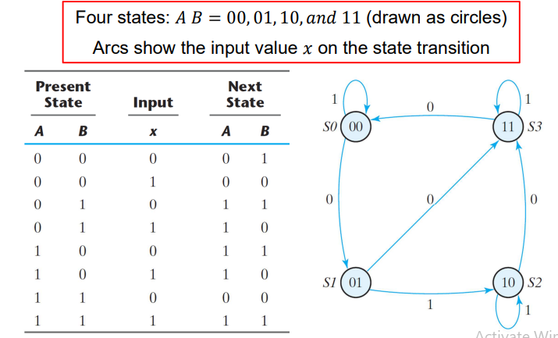
Analyzing a Clocked Sequential Circuit

Slide 48
THANKS

